Slide 1
GAS LEAKAGE MONITORING AND ALERTING SYSTEMS
Team ID:
PNT2022TMID21386
Team members
917719D053-Muthu Veni V
917719D054-Nandhini P
917719D084-Senthilkumar C
917719D134-Swetha K

Slide 2
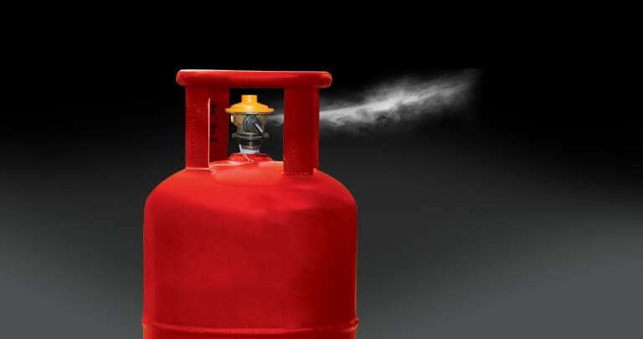
PROBLEM STATEMENT
A homemaker trying to detect the gas leakage, but manual detection of leakage may not be accurate. Because it requires an alerting and monitoring mechanism which makes them feel that could cause a field accident.

Slide 3
PROPOSED SOLUTION
System consists of gas detector sensors, Arduino board, ESP8266 and Cloud server. One Society authority person can register the all ﬂat member user to our system.
Society admin can add the details of per ﬂat user such as user name, mobile number, per user ﬂat sensor details information. Society admin can conﬁgure the threshold value of each sensor.
System hardware can be deployed on each ﬂat. Sensors can sense the value per time. System can send the values to cloud server.
Server can Check that the sensor values was existed the threshold value. If sensor value can cross the limit the server can send the command to hardware for buzzing the alarm. Server also sends the notiﬁcation message to user

Slide 4
TECHNICAL ARCHITECTURE
S.NO | Component | Description | Technology
1. | User Interface | How user interacts with application e.g. Web UI, Mobile App, Chatbot etc. | HTML, CSS, JavaScript / Angular Js /React Js etc
2. | Application Logic-1 | Logic for a process in the application | Java/Python
3. | Application Logic-2 | Logic for a process in the application | IBM Watson STT service
4. | Application Logic-3 | Logic for a process in the application | IBM Watson Assistant
5. | Cloud Database | Database Service on Cloud | IBM DB2, IBM Cloudant etc.
6. | Infrastructure (Server / Cloud) | Application Deployment on Cloud | Local, Cloud Foundry, Kubernetes, etc.

Slide 5
TECHNICAL ARCHITECTURE : Application Characteristics
S.No | Characteristics | Description | Technology
1. | Scalable Architecture | We can implement in Industries, Hotels, Public places | IOT
2. | Availability | To detect leakage 24/7 for uninterrupted services we have implemented in distributed servers (cloud) | IBM cloud
3. | Performance | If we implemented in industries, it needs many gas sensors to detect

Slide 6
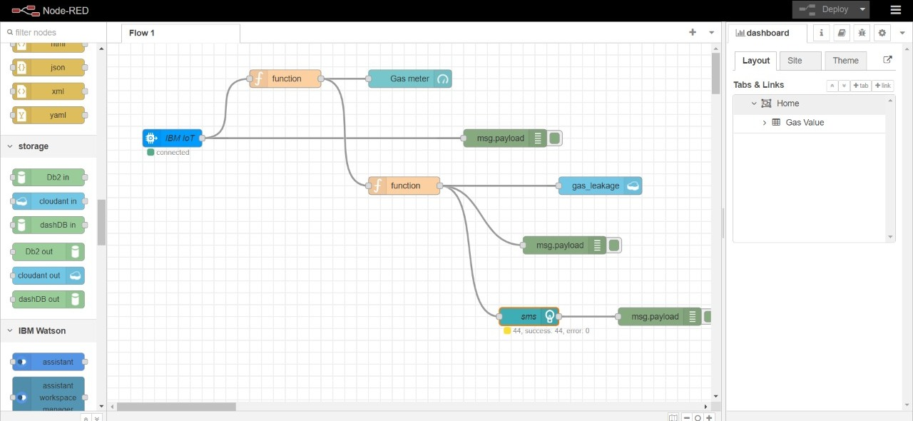
DEMO : NODE RED

Slide 7
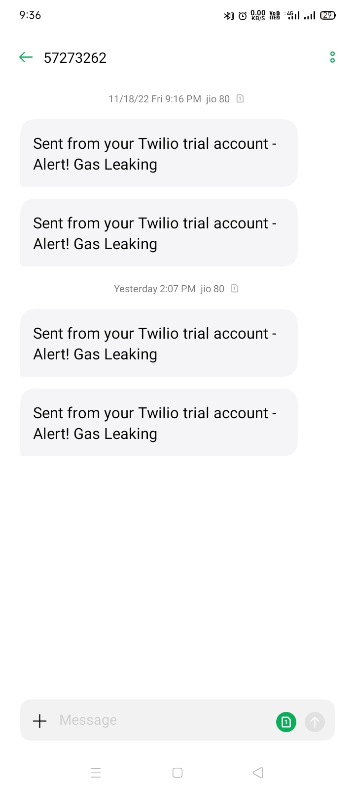
RESULT

Slide 8
FUTURE SCOPE
Future scope could be including a Automatic Shut-off device which will turn off the gas supply whenever it will detect any gas leakage.
This system can be implemented in Industries, Hotels and wherever the LPG cylinders are used. The system can be taken as a small attempt in connecting the existing primary gas detection methods to a mobile platform integrated with IoT platforms.
The gases are sensed in an area of 10m radius of the rover and the sensor output data’s are continuously transferred to the local server. The accuracy of sensors are not up to the mark thus stray gases are also detected which creates an amount of error in the outputs of the sensors, especially in case of methane.
Hence in the future we have to come up with better solutions for these Problems.

Slide 9
DEMO VIDEO LINK:
https://drive.google.com/drive/folders/1biikkkLXADrCskCsyo5kLI9NEcJQWtFU?usp=sharing

Slide 10
THANK YOU

